Slide 1
Representation Learning of Users and Items for Review Rating Prediction
Using Attention-based Convolutional Neural Network
Sungyong Seo* Jing Huang† Hao Yang† Yan Liu*
* Computer Science Department, University of Southern California
† Visa Research, Visa Inc.
Soohyun Son, AI lab

Slide 2
CONTENTS
01
Contributions
02
Motivation
03
Proposed Model
04
Experiments

Slide 3
01
Contributions
After you read . . .

Slide 4
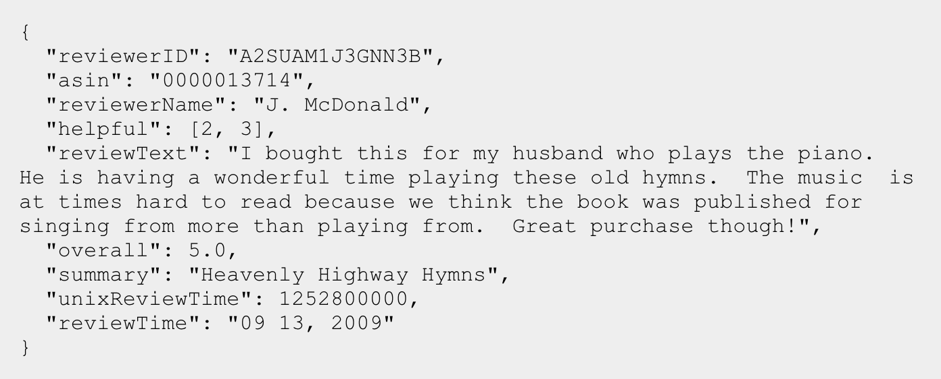
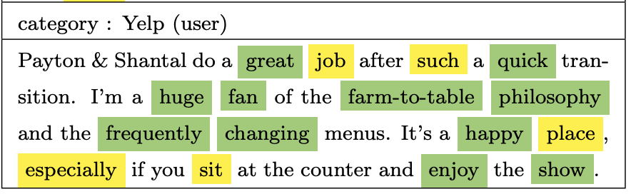
01.
Contributions
- You can make high performance recommend system using review text.
Amazon review data ( example )
- You can interpret the recommend result by attention layer.
Highlighted words by attention layer ( explain later )

Slide 5
02
Motivation
Previous works and limitation
Objective
MF(Matrix Factorization)
Why not use review text?
HFT(Hidden Factors and Topics)
Perspective of proposed method

Slide 6
02.
Motivation
Objective
Making good recommend system. -> predicting user’s rating in the future.

Slide 7
02.
Motivation
MF(Matrix Factorization)
Notes:
Finding latent feature matrices corresponding to latent features of users and items, and important weights of these latent factors.
Limitations
Hard to recommend to users with few ratings or to recommend items with few ratings(cold start problem)
Hard to recommend items to a user with unique preferences because rating numbers alone are inadequate to learn the user’s preferences
Poor interpretability, making understanding of users preferences impossible.
(particular latent features from MF with tue understanding of users and items)
Large positive weight on that feature (no clue what this feature means)

Slide 8
02.
Motivation
Why not use review text?
Notes:
Most shopping wibsites encourage their users to rate shopping items and write review text.
Review text explains why a user assigns such a rating to an item.
Review text complements the rating numbers by their users to rate shopping items and write review text.
(implicit preferences of users)
A set of all reviews from this user allows us to derive this users’ preferences; similarly a set of reviews on an item describes prominent properties of the item rated by many users.
These preferences of a user and properties of an item can then be leveraged to alleviate the cold-start problem when the ratings are few.

Slide 9
02.
Motivation
Interpretable latent topic models ( HFT model, RMR model … )
Latent topic distribution from item documents
Nice!
User-specific meaning of words is different
Nice!
Notes:
Interpretable latent topic models on item review text
An item document consists of all reviews of an item; and the latent topic distrivbution is derived from these item documents.
The topics discovered from item documents may not be suitale for users
We believe the aggregated review text of items cannot cover the same sentimental expressions in each individual user.
Same word “nice” might indicate different sentimental meaning from different users, while one user links “nice” to a rating of 4, another may link it to a rating of 5 using the same word.
We should not just discard user-specific meanings of words and ignore their effect on the ratings by just assuming the topic distribution is the same as those in item review.
Each user has their own preferences or tastes that can be discovered using all review text written by this user.

Slide 10
02.
Motivation
Perspective of proposed method
Item’s properties (latent variables)
Find relationships
User’s preferences(latent variables)

Slide 11
03
Proposed Model
Catch user preferences, item properties

Slide 12
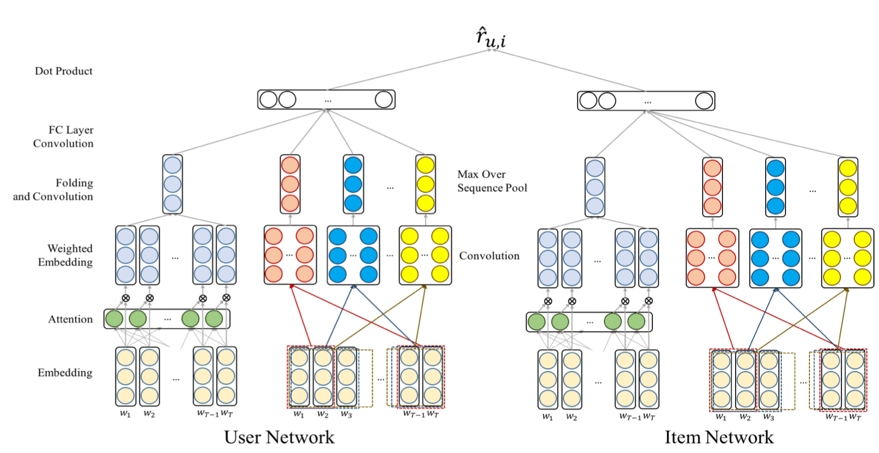
03.
Proposed Model

Slide 13
03.
Proposed Model
Embedding layer

Slide 14
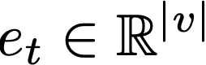
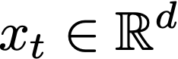
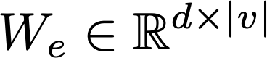
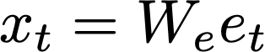
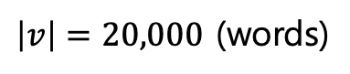
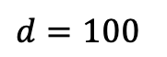
03.
Proposed Model
Embedding layer
Input : review document $D_{u}$ ( a set of review from user u ) -> transform one-hot vector
$\left|v\right|=20,000$ (words)
Embedding layer reads one-hot vector for a word as an input, and map it to a dense vector
$d=100$
In this paper, they use pre-trained word embedding fastText based on the skip-gram model

Slide 15
03.
Proposed Model
Embedding layer

Slide 16
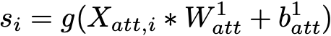
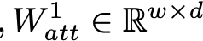
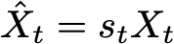
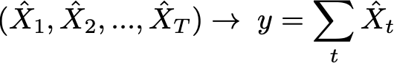
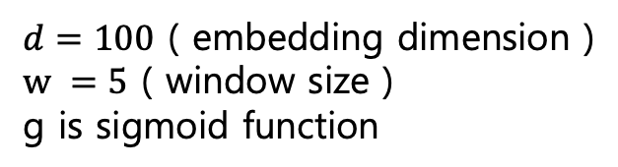
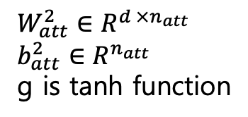
03.
Proposed Model
Attention module on the left
Let $D_{u}$ be represented as a length $T$ word embeddings $(x_{1},x_{2}, …,x_{T} )$.
$d=100$ ( embedding dimension )
$w =5$ ( window size )
g is sigmoid function
$W_{att}^{2}∈R^{d ×n_{att}}$
$$b_{att}^{2}∈R^{n_{att}}$$
g is tanh function

Slide 17
03.
Proposed Model
Embedding layer

Slide 18
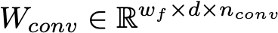
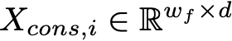
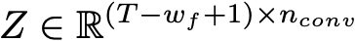
03.
Proposed Model
Convolutional module on the right
Length of a filter as $w_{f}=\left\{2, 3, 4, 5\right\}, n_{conv}=100$

Slide 19
03.
Proposed Model
Embedding layer

Slide 20
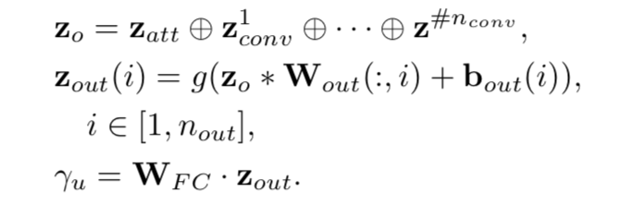
03.
Proposed Model
Final layers

Slide 21
03.
Proposed Model
Embedding layer

Slide 22
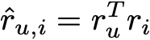
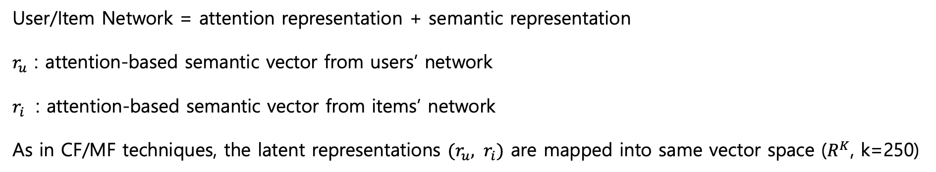
03.
Proposed Model
Training of the network
User/Item Network = attention representation + semantic representation
$r_{u}$ : attention-based semantic vector from users’ network
$r_{i}$ : attention-based semantic vector from items’ network
As in CF/MF techniques, the latent representations $(r_{u}, r_{i})$ are mapped into same vector space ($R^{K}$, k=250)
The estimation can be considered as a regression problem.
Error function : MSE(Mean Squared Error)

Slide 23
04
Experiments
Yelp, Amazon dataset

Slide 24

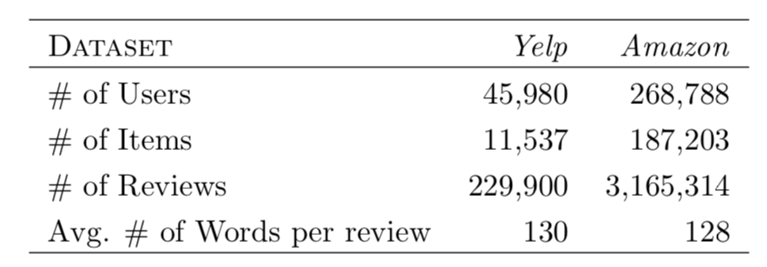
04.
Experiments
Dataset
Yelp dataset : reviews on restaurants in Phoenix, AZ metropolitan area
Amazon product dataset : 5-core(subset of the data in which all users and items have at least 5 reviews )
Randomly divided dataset -> training(80%), validation(10%), test(10%) set

Slide 25
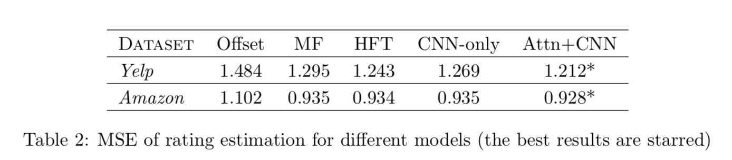
04.
Experiments
Results

Slide 26
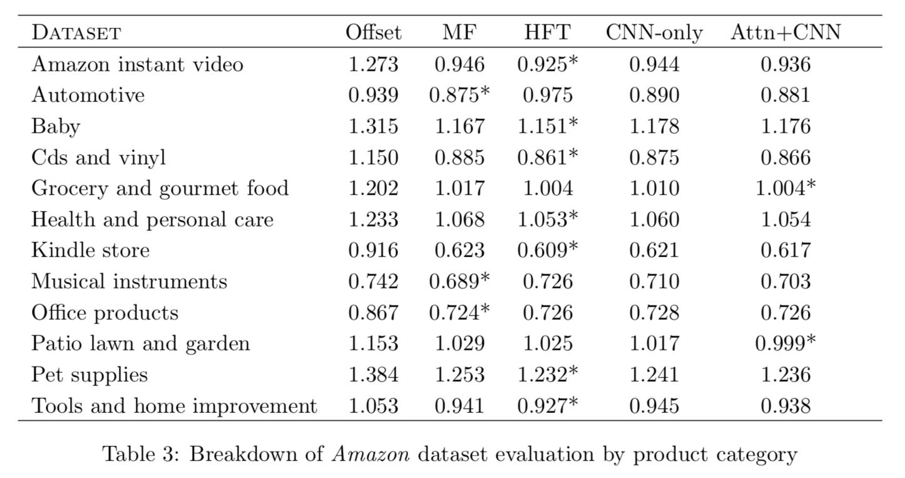
04.
Experiments
Results

Slide 27
04.
Experiments
Detail of the results (Amazon dataset)
User-sentiment consistency
- Sentiment ratings from the same user are more consistent than those other users.
Item-sentiment consistency
- Sentiment ratings towards the same item are more consistent than those towards different items.
User-text consistency
- A user likes to use personalized sentiment words when expressing opinion polarity or intensity.
Item-text consistency
- An item has a collection of item-specific words suited to evaluate it.

Slide 28
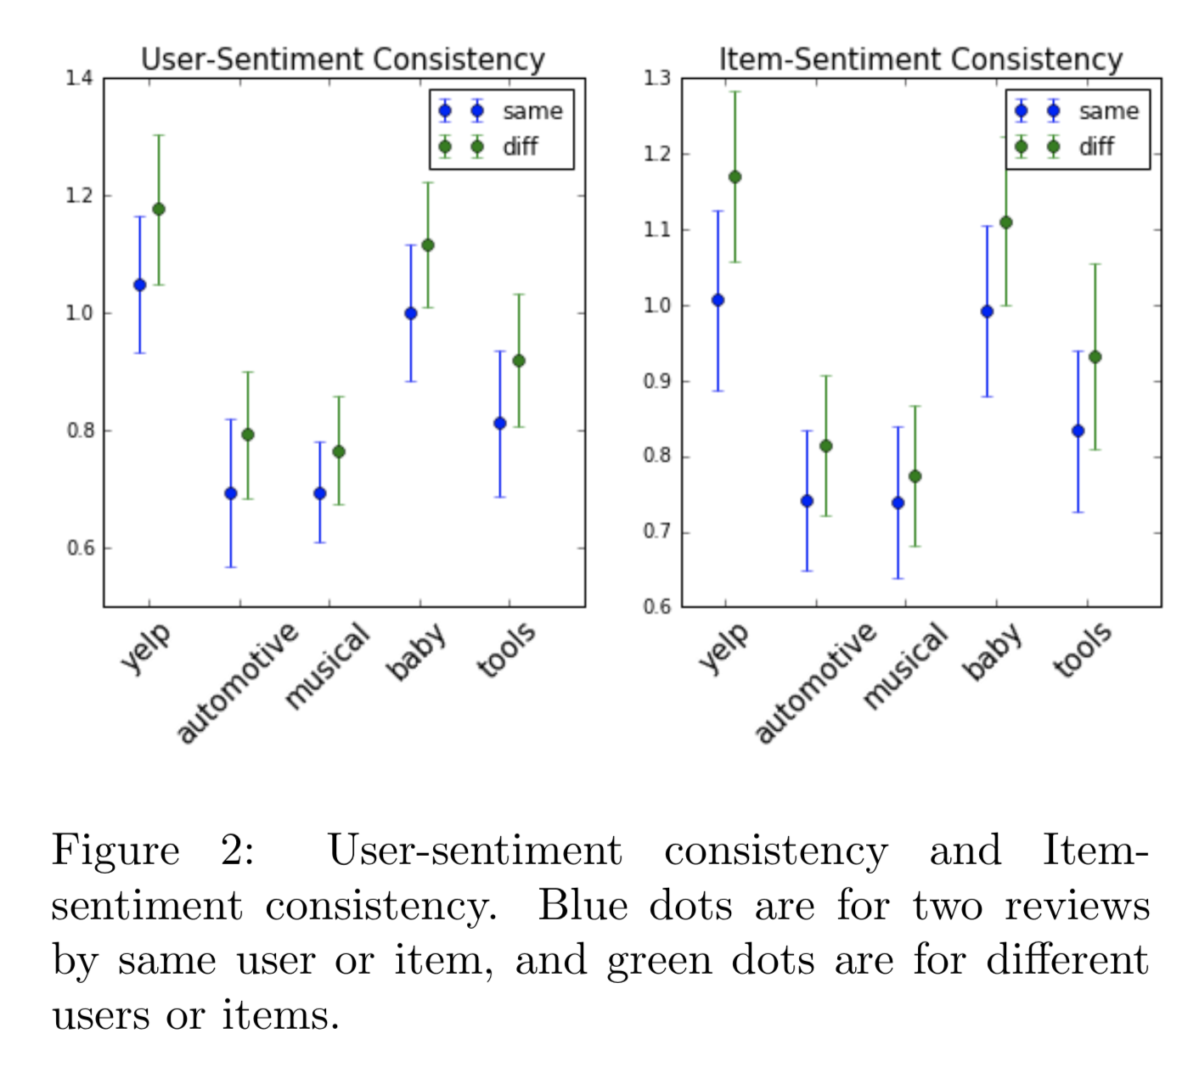
04.
Experiments
Detail of the results (Amazon dataset)
MF was best

Slide 29
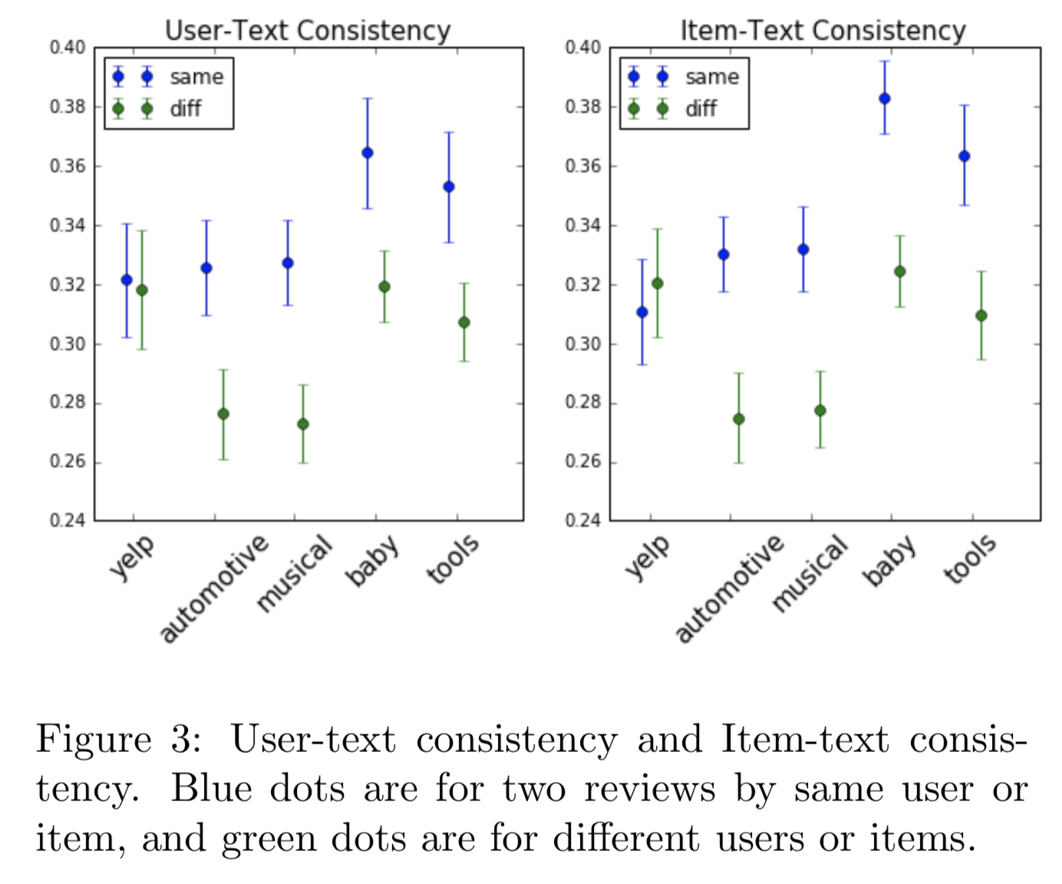
04.
Experiments
Detail of the results (Amazon dataset)
HFT was best

Slide 30
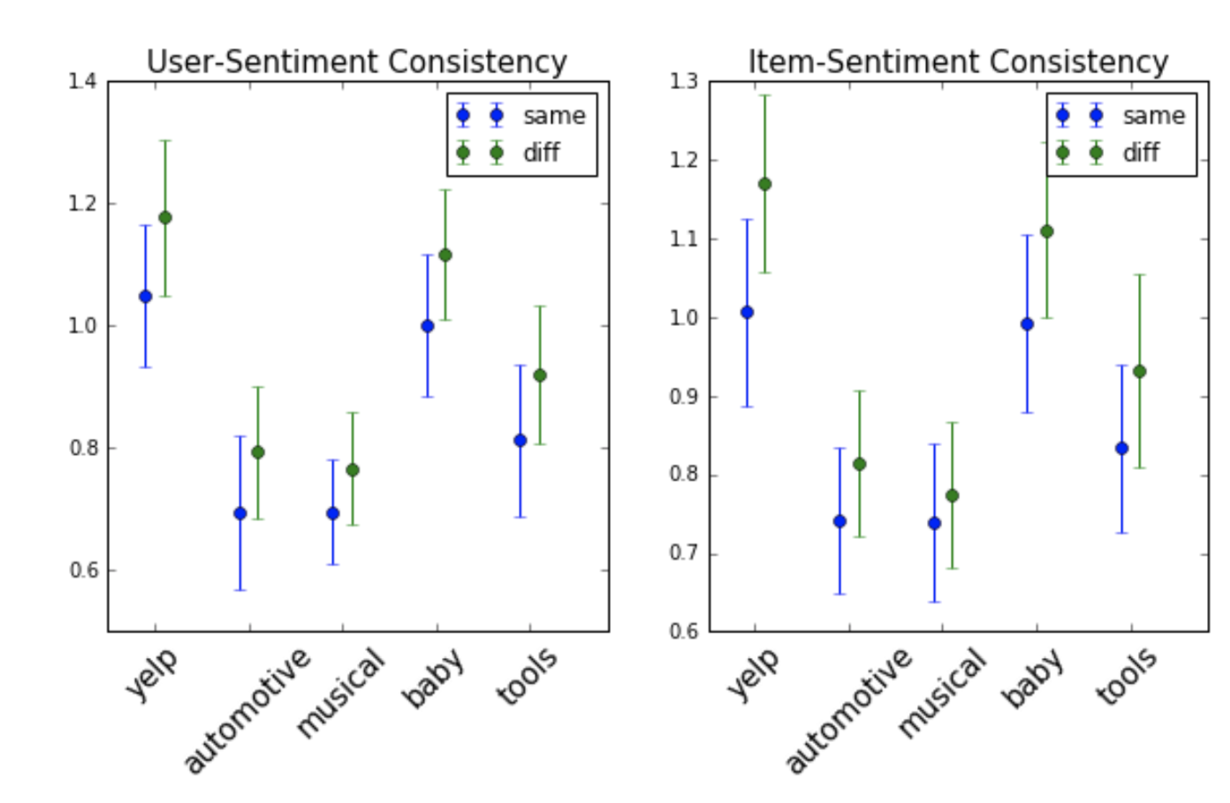
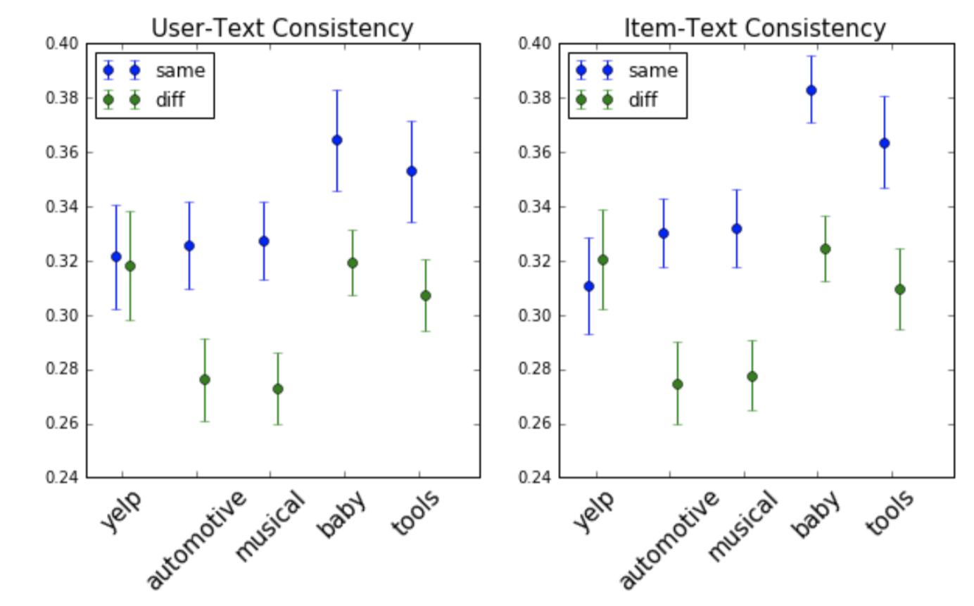
04.
Experiments
Detail of the results (Yelp)
Ratings in Yelp dataset are inconsistent.
But proposed model performed best.

Slide 31
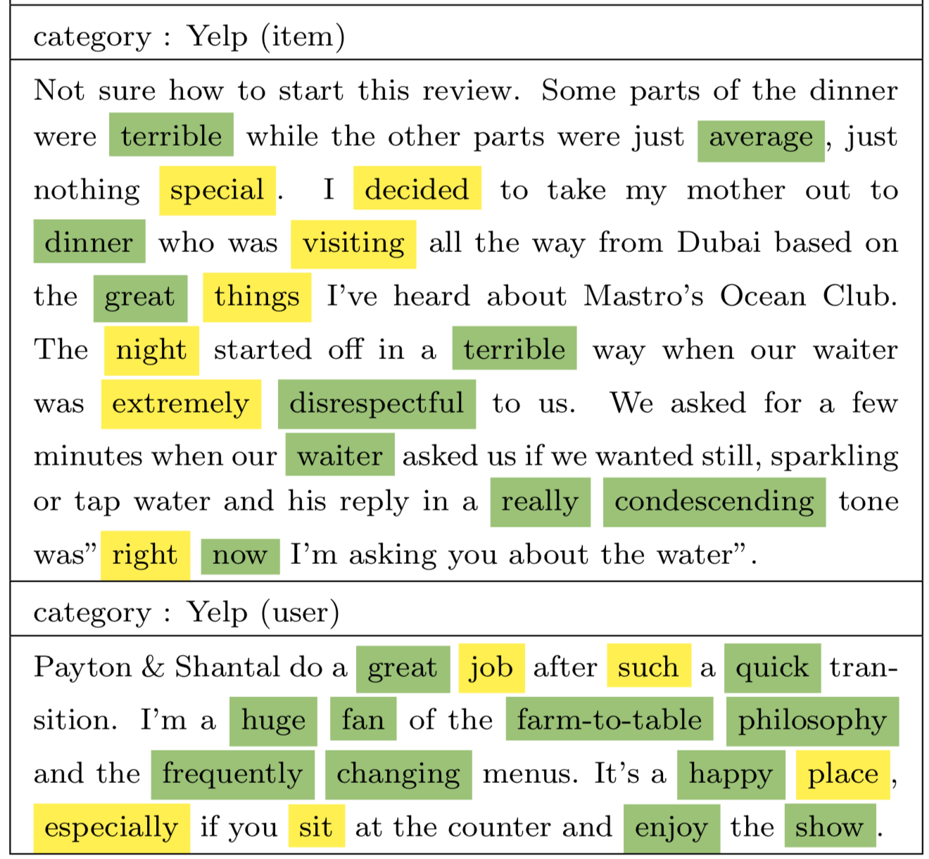
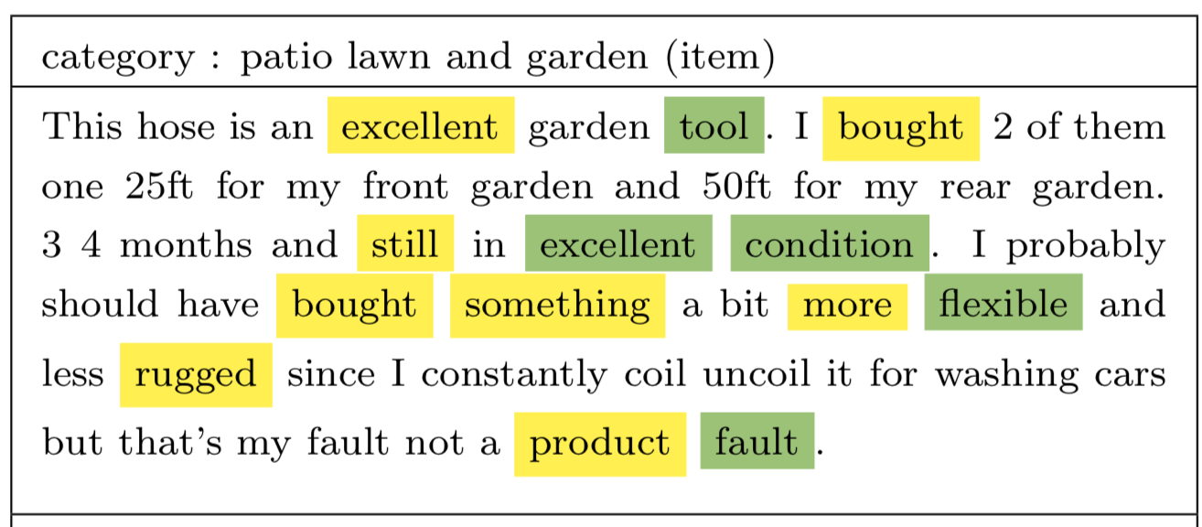
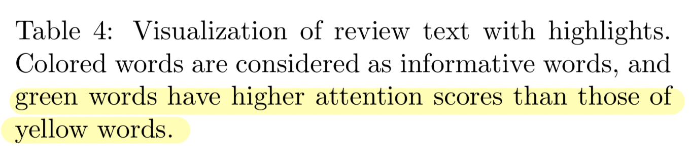
04.
Experiments
Visualize Attention Keywords

Slide 32
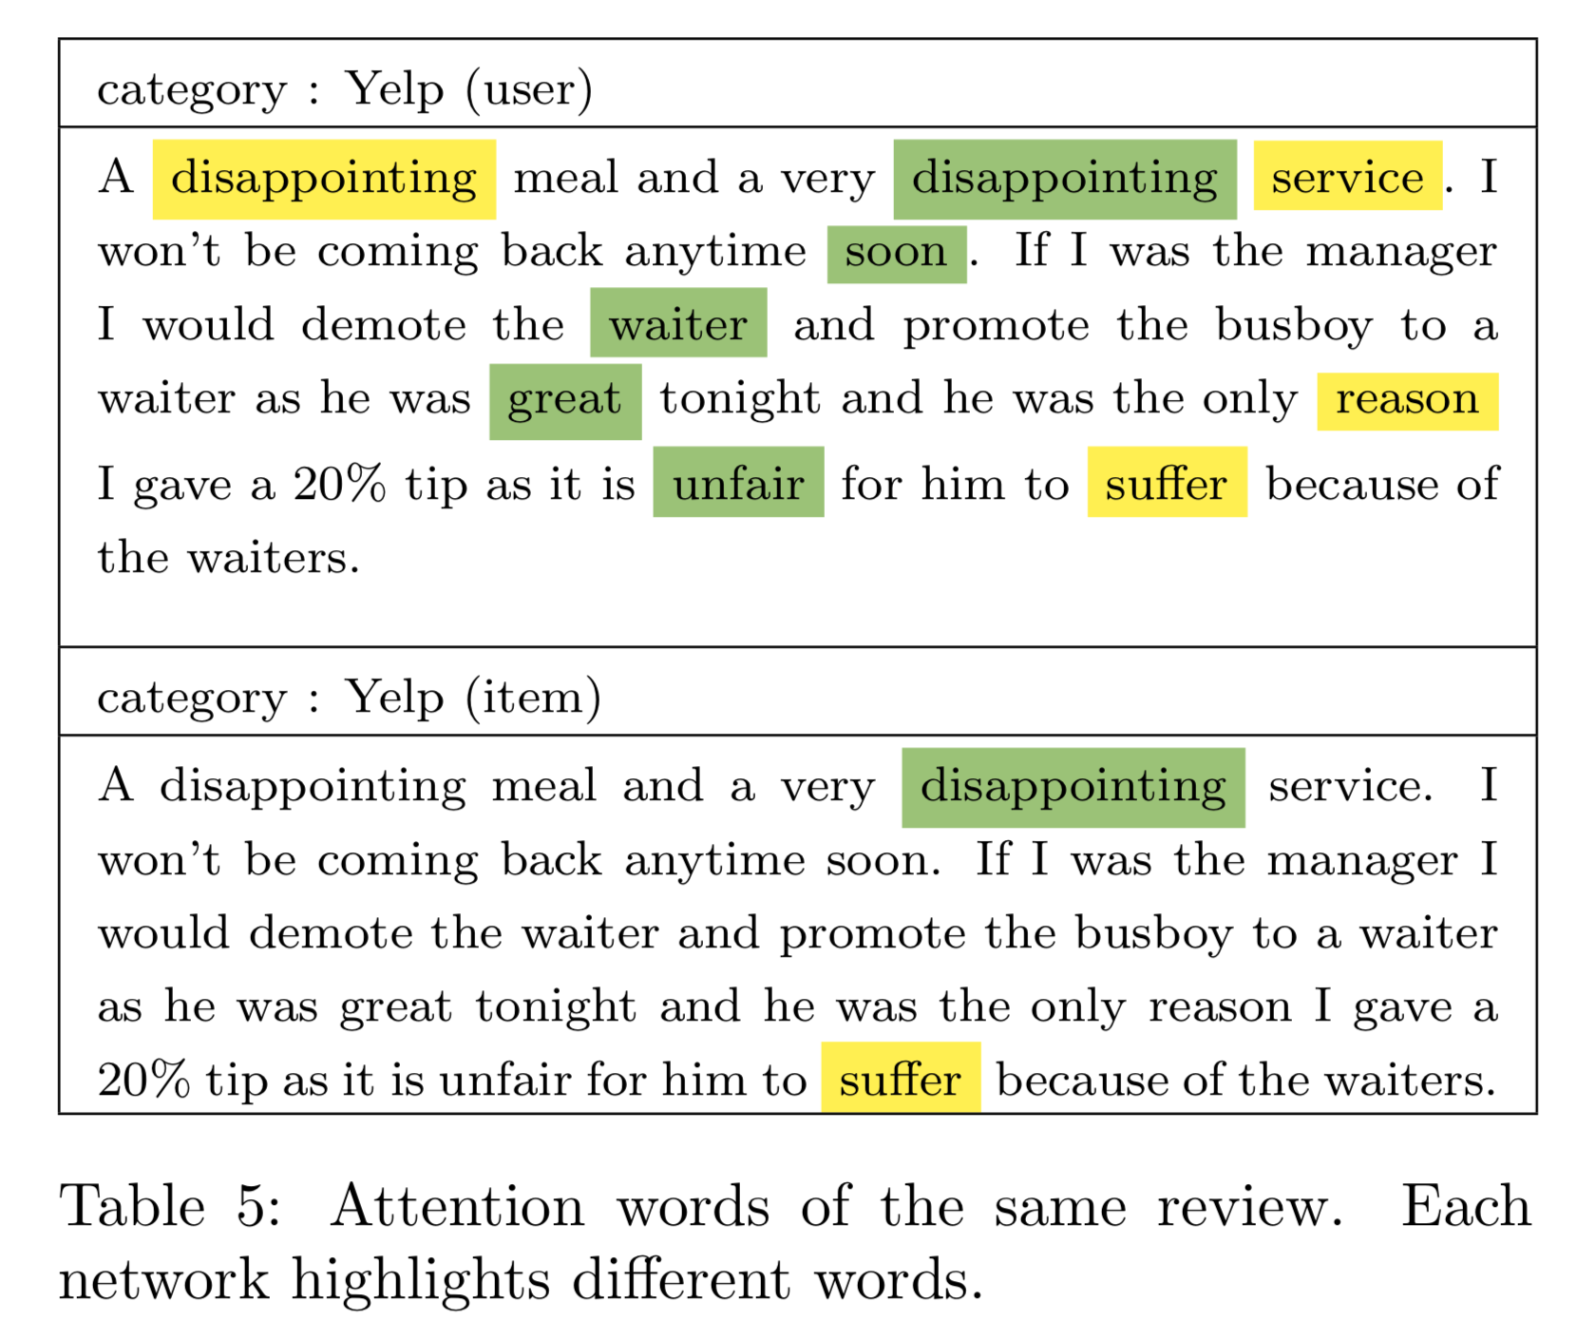
04.
Experiments
Visualize Attention Keywords

Slide 33
Thank you

